Slide 1
Stock Price Analysis
Shubhaan Saxena

Slide 2
Research Question
How do macroeconomic factors influence the behavior of the stock market?
Parameters:
overall stock market performance within the U.S
NASDAQ- tracks the performance of the Nasdaq Stock Market, a platform consisting of over 4,100 securities being bought and sold
S&P 500 (Standard & Poor’s 500 Index)- top 500 publicly traded companies
Macroeconomic Indicators:
Gross Domestic Products (GDP)- value of all goods & services produced in a country during a specific time period
Consumer Price Index (CPI)- measures price changes in goods & services (inflation)
Interest- cost of borrowing & yield of investments within an economy

Slide 3
Data Sets
NASDAQ.csv- date, open, high, low, close, adjusted close, and volume within the NASDAQ index (1971-2024)
SPX.csv- date, open, high, low, close, adjusted close, and volume of the S&P 500 represented (1960-2024)
CPI. csv- representation of inflation (1947-2024)
Interest_rates.csv- interest rate at which institutions lend reserve balances; federal fund rate (1954-2024)
GDP.csv- average value within US’s economy (1960-2023)
Cleaning/Merging:
Null rows
Organized by date (inconsistent frequencies from market closures)
merged_sp500- included all the macroeconomic columns + S&P 500 data
merged_nasdaq- included all the macroeconomic columns + NASDAQ data

Slide 4
Exploration
Goal: determine trends during specific time periods; cross-analyze with macroeconomics to describe what may have caused changes in the stock market
Minimum/Maximum: values of different variables (GDP, stock price, CPI, inflation rate, etc) within merged_nasdaq; observations indicated that the GDP, CPI, stock price were heavily correlated (similar trends)
Two drastic dips in inflation & interest rates in 2009 & 2020 (housing crisis & COVID-19)
Cross analyzed these two time periods with stock prices; verified a consistent sharp decline
Correlation analysis:
Established S&P 500 values were more favorable over NASDAQ in terms of correlation
Ex: GDP higher correlation to merged S&P 500 over NASDAQ
Inflation had low correlation to stock price, but strong correlation to interest rates
Time Series/Scatterplot:
Verified the relationship between inflation and interest rates
Observed similar trends
Understanding: As prices of goods/services increase (inflation), people require more money to fund their lifestyle, hence the cost of borrowing money (interest) increases because of the demand

Slide 5
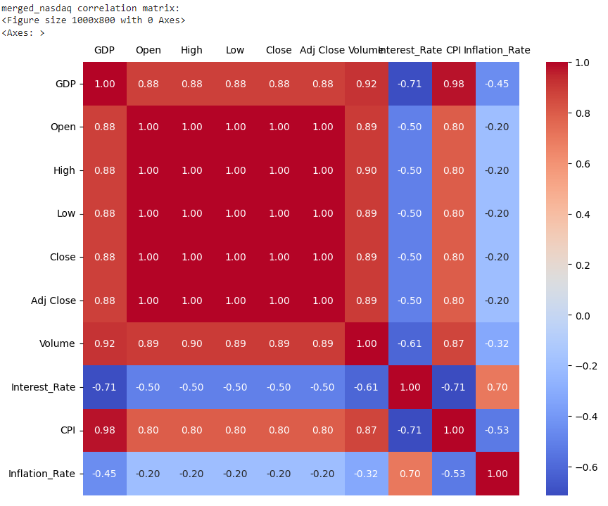
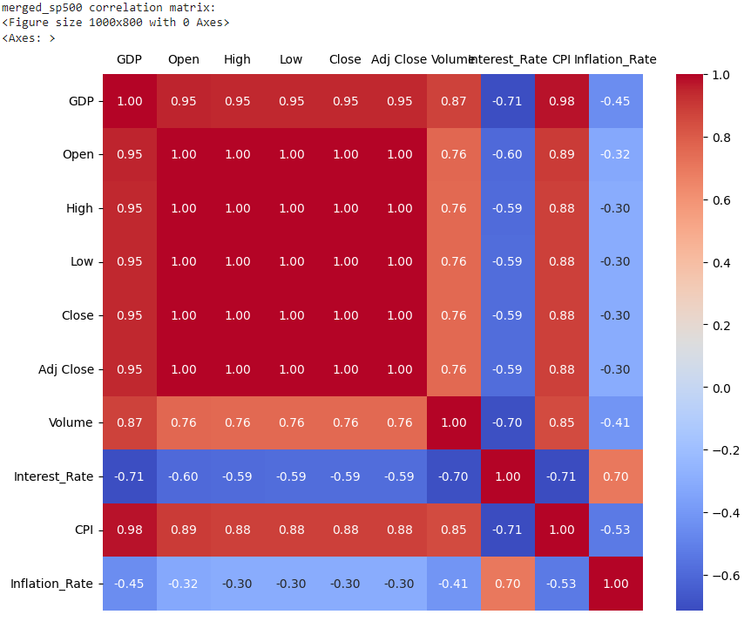
Correlation Analysis
(heatmaps from Seaborn)

Slide 6
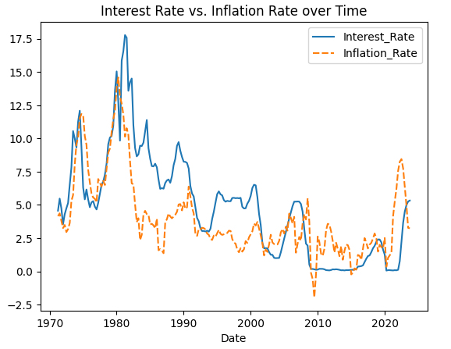
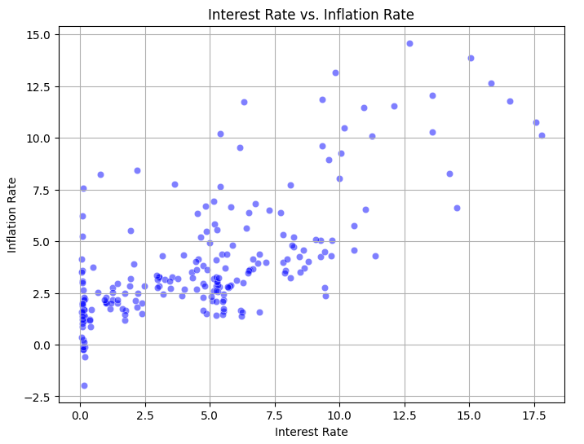
Time Series & Scatterplot

Slide 7
Linear Regression
Between close price & GDP
Observations:
Unable to follow the actual trend; stock market is never linear
GDP is not the only factor determining stock market prices
Generated values: MSE (Mean Squared Error): 129483.196 & MAE (Mean Absolute Error): 263.331
For confirmation, a residual analysis was conducted, didn’t see a consistent spread of data points and a general randomness
Attempted to incorporate GDP lags of 1 quarter (merged_sp500.GDP.shift(1))
Results: 50 data points, MSE of 110.1, MAE of 8.3
Normal GDP model had an MSE of 107.53 and an MAE of 8.25
Created a Previous column, with Close prices from the previous quarter using the shift(1) function
This model was able to generate an accurate prediction of the current Close values
Downside: used stock price data, and not macroeconomic data to achieve these results

Slide 8
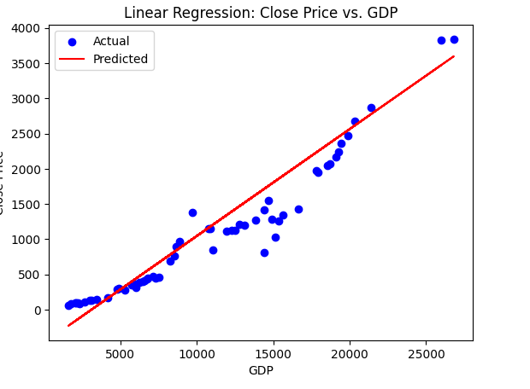
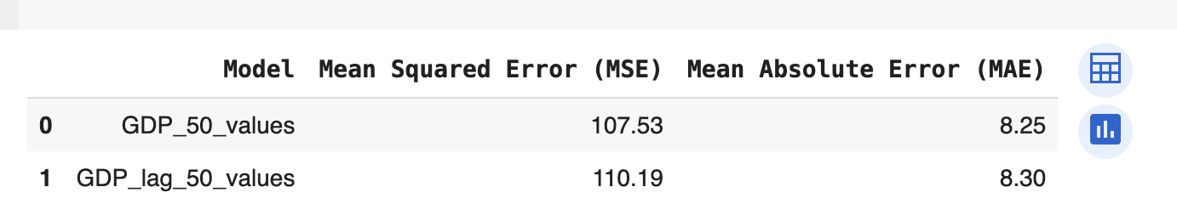
Linear Regression Cont.

Slide 9
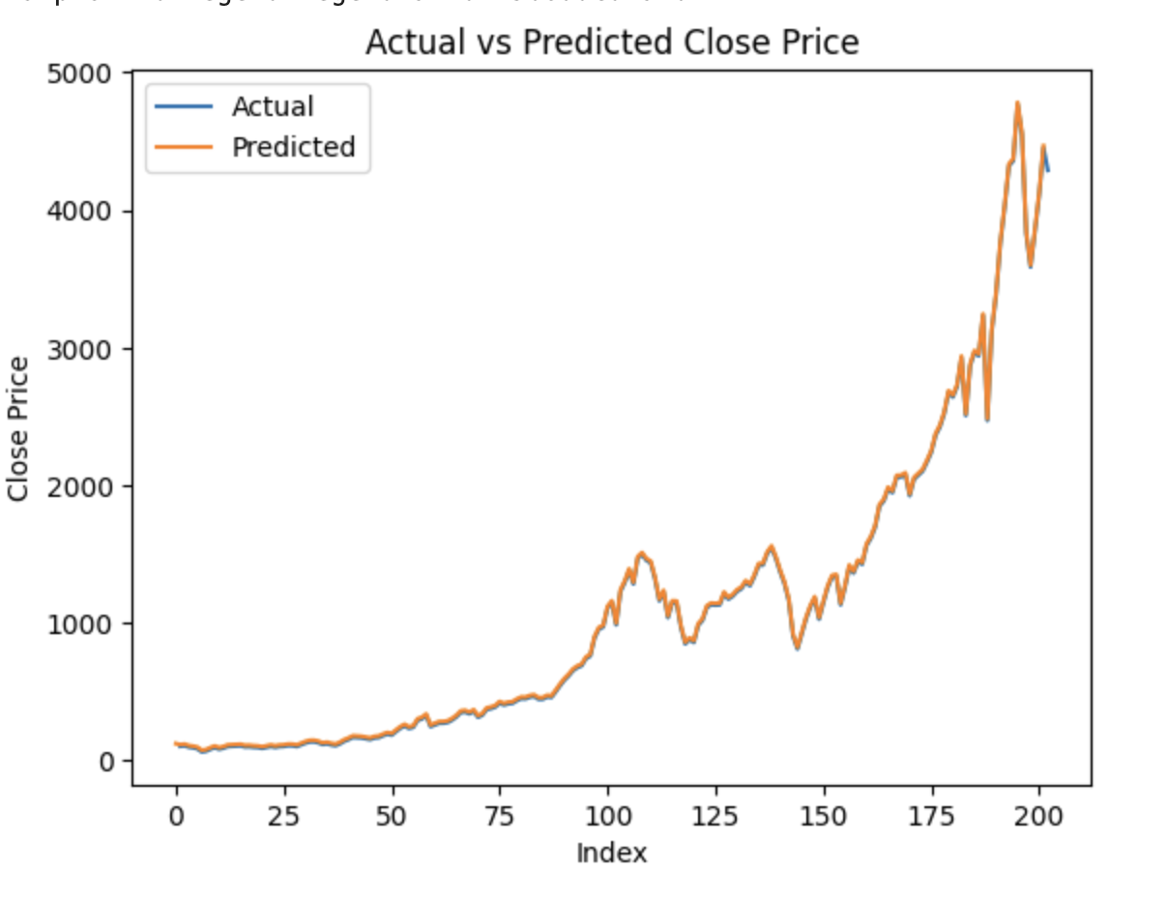
Linear Regression Cont.

Slide 10
Classification
Determine which periods would lead to positive/negative rates of returns
Column Return was computed by calculating the rate of returns from one quarter to the next
Decision tree model was initialized such that X included all columns besides Return, Close, Forecast, Adj Close and Date, as most of these were too correlated to be used as a means to split the data
Target variable had Return and would output 0 in the case of a negative return, and 1 for a positive return
Result: 74% probability of predicting a favorable investment, model accuracy was only 64%
Second decision tree (different independent variables)
Focus on macroeconomic factors and also added the Previous column indicating Close prices from the previous quarter

Slide 11
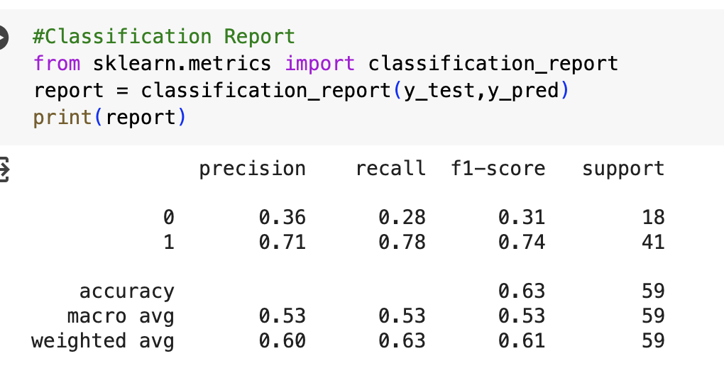
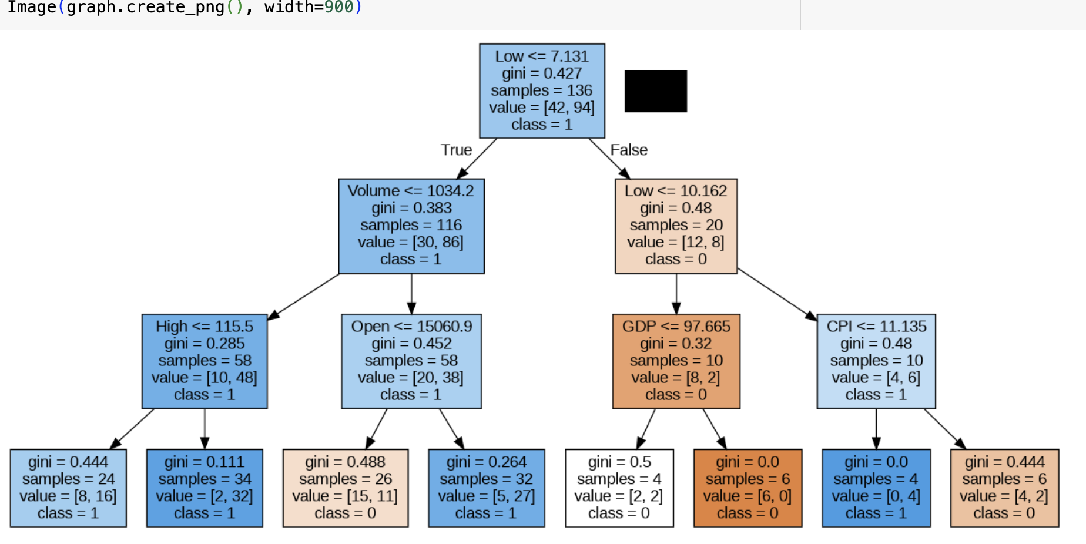
Classification Cont

Slide 12
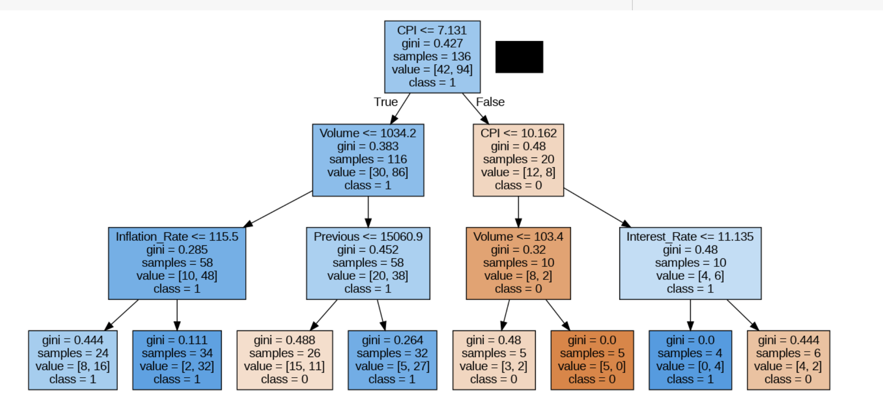
Classification Cont

Slide 13
Conclusion
Goal: explore the relationships between macroeconomic factors and stock prices
Recap:
Uncover trends through various methods: pandas functions, using correlation matrices,time series analysis, and other various visualizations
Used knowledge from these trends to predict stock prices using the macroeconomic factors
Using linear regression, we were unable to achieve a satisfying prediction using GDP data
However, it makes sense that GDP alone is sufficient to predict stock prices, at least through linear regression
Created decision trees w/ accuracy of 74% for favorable times to invent
Change we would make:
implement more complex machine learning models
Thank You
Q&A

